Slide 1
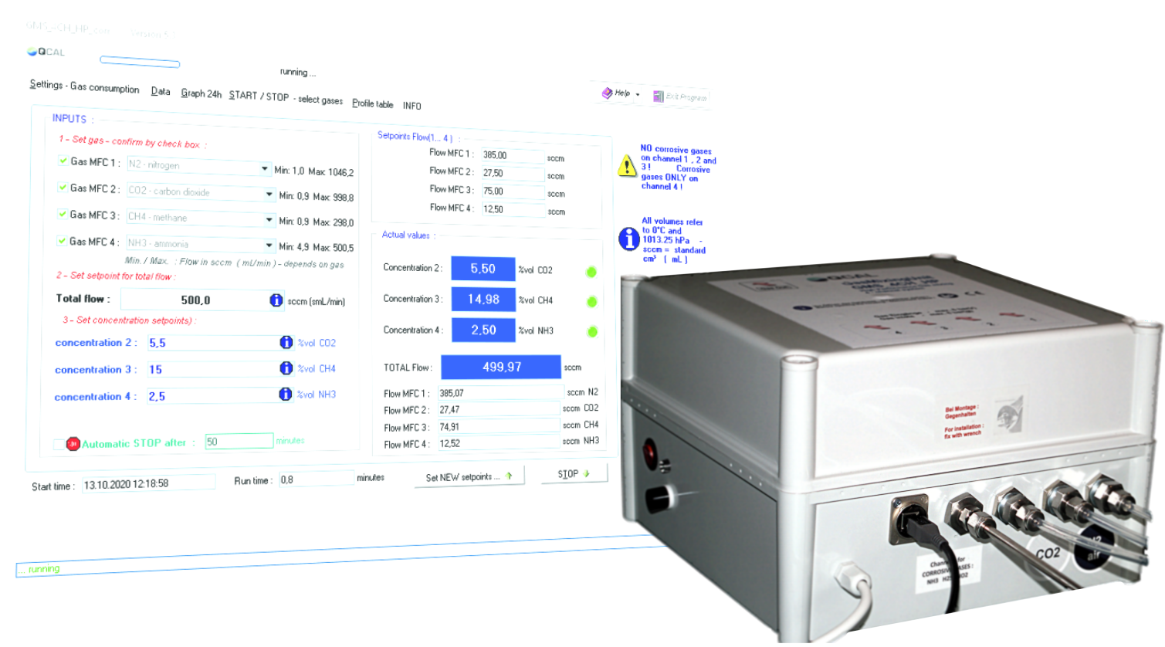
QCAL Messtechnik presents :
GMS_4CH_corr
Gas mixing with corrosive gases
High performance gas mixer with
1, 2 or 3 channels for corrosive gases

Slide 2
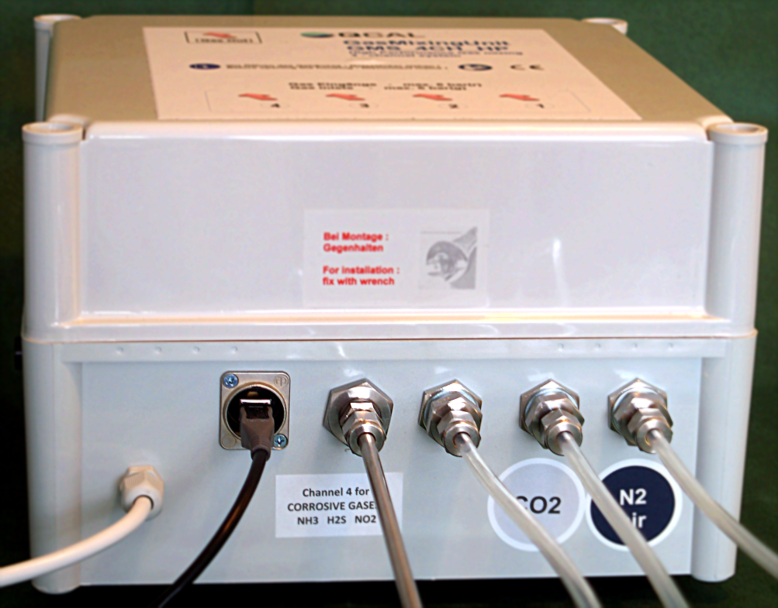
Example : GMS_4CH_HP_corr 4 – channel gas mixer
4
3
2
1
Channel 1 : N2 / air / Ar / He - range : 1 : 1000 ( e.g. 1 to 1000 sccm )
Channel 2 : CO2 / methane ( CH4 ) / nitrous oxide ( N2O ) - range : 1 : 1000
Channel 3 : low-concentration gas mixtures with corrosive components :
1000 ppm SO2 in N2 / 100 ppm NOx ( NO/NO2 ) in N2 - range : 1 : 1000
Channel 4 : pure corrosive gases :
sulphur dioxide SO2 ( 100% ) / ammonia NH3 ( 100% )

Slide 3
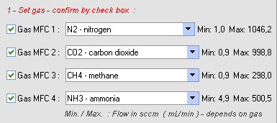
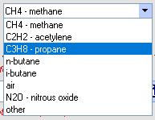
The gases for each channel are listed and selected from the GMS software …
For each non-corrosive gas is valid :
Real Calibration with the listed gas - not calculated from gas factors or MultiGas functions :
?
Gas factors and calculation functions give an unknown uncertainty !
Flow Range : 1 : 1000 . The controller is calibrated over the entire flow range.
Example : 0.5 … 500 sccm .
Resulting in an unrivalled concentration range

Slide 4
QCAL Messtechnik GmbH www.qcal.de

